Slide 1
DEPI
pROJECT

Slide 2
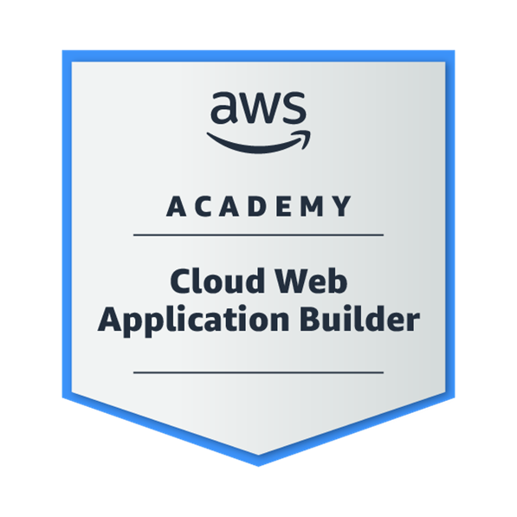

Agenda
Highly Available, Scalable Web Application
Securing and Monitoring Resources with AWS

Slide 3
Highly Available, Scalable Web Application

Slide 4

Project Statement
Problem Statement: Fiction University’s student records web application is slow and unreliable, especially during the peak admissions period. High traffic volume causes downtime and poor user experience, leading to complaints from applicants and staff. The web application needs to handle thousands of users efficiently while ensuring minimal downtime and high performance.

Slide 5
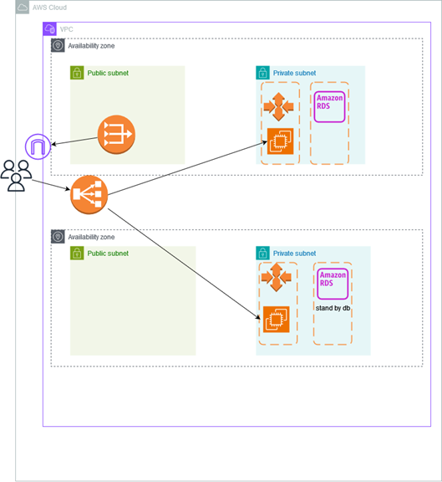
Problem Overview
Utilize AWS services to enhance scalability, high availability, security, and performance.
Ensure the solution can support thousands of users during peak admissions periods.
Enable functionality to view, add, delete, and modify student records without perceivable delay under normal or high traffic loads.
Optimize costs by using efficient resource configurations and scaling mechanisms.
Ensure the application is secure with properly configured network settings and database protection.

Slide 6

Expected Outcomes
Ensure high availability and fault tolerance by distributing traffic across multiple servers using a load balancer.
Enable auto-scaling to manage varying traffic loads and ensure resources are used efficiently.
Secure the database, making it inaccessible from public networks and ensuring that credentials are safely managed.
Achieve cost optimization by selecting appropriate instance types and service configurations.
Provide a high-performing application experience without noticeable delays even during peak loads.

Slide 7
Services Used
Amazon EC2: To deploy and run the web application on virtual machines.
Amazon RDS: A managed relational database service (for securely storing student records).
Amazon VPC: To create an isolated virtual network with secure configurations for public and private subnets.
Amazon Load Balancer (ALB): To distribute incoming traffic across multiple EC2 instances.
Amazon Auto Scaling: To dynamically scale the number of EC2 instances based on demand.
IAM: To manage access permissions and security policies between AWS services.
Amazon CloudWatch: For monitoring the performance and health of the application and its components.
AWS Pricing Calculator: To estimate and manage costs based on the services used in the architecture.

Slide 8
Expected Outcomes
Ensure high availability and fault tolerance by distributing traffic across multiple servers using a load balancer.
Enable auto-scaling to manage varying traffic loads and ensure resources are used efficiently.
Secure the database, making it inaccessible from public networks and ensuring that credentials are safely managed.
Achieve cost optimization by selecting appropriate instance types and service configurations.
Provide a high-performing application experience without noticeable delays even during peak loads.

Slide 9
Phase 1: Planning the design and estimating cost

Slide 10
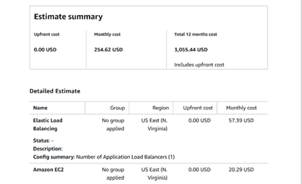
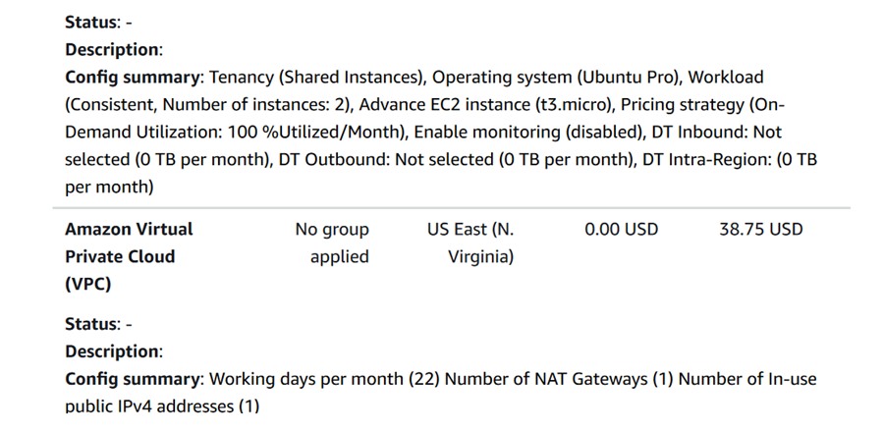
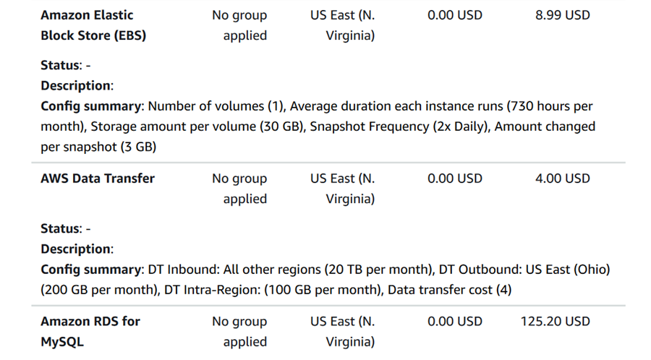
Cost Optimization
Learn to infuse energy into your delivery to leave a lasting impression
One of the goals of effective communication is to motivate your audience

Slide 11

Architecture Diagram

Slide 12
Phase 2: Creating a basic functional web application

Slide 13
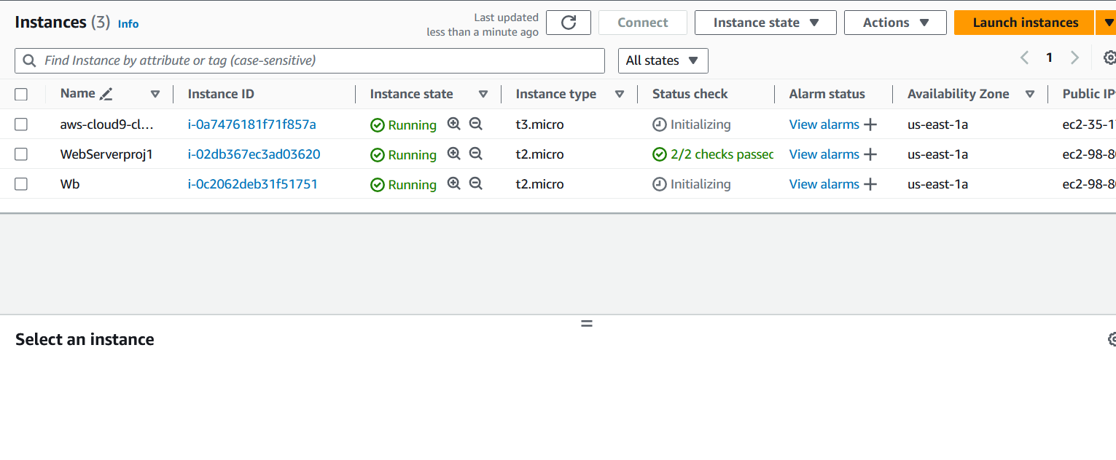
Creating a virtual machine

Slide 14

Testing the deployment

Slide 15
Phase 3: Decoupling the application components

Slide 16
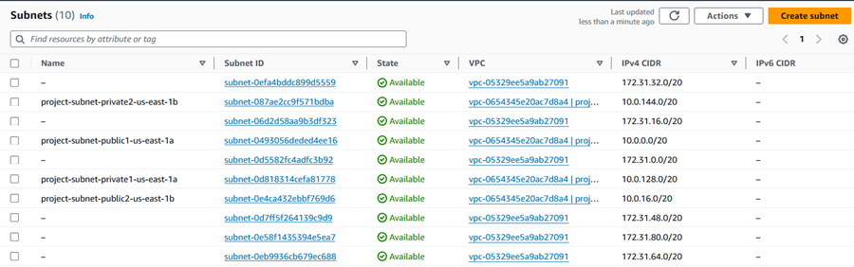
Changing the VPC configuration

Slide 17
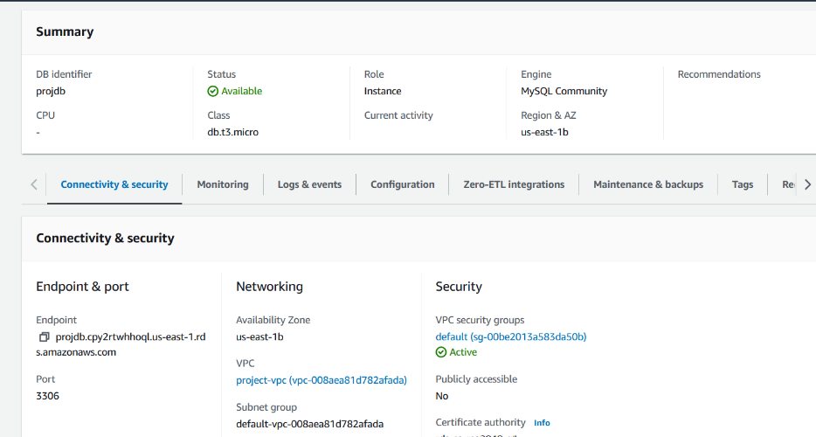
Creating and configuring the Amazon RDS database

Slide 18
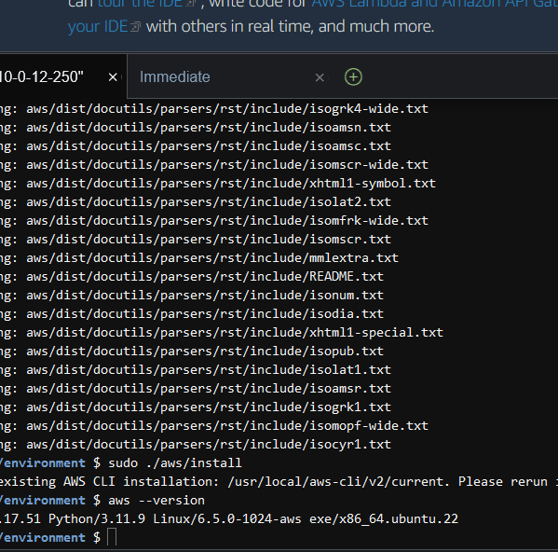
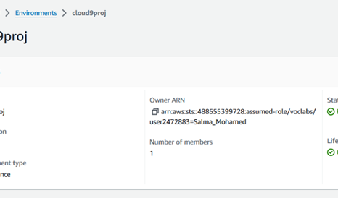
Configuring the development environment

Slide 19
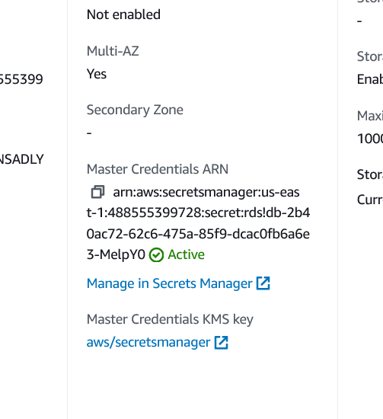
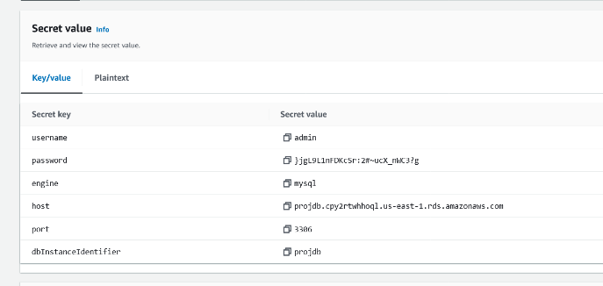
Provisioning Secrets Manager

Slide 20
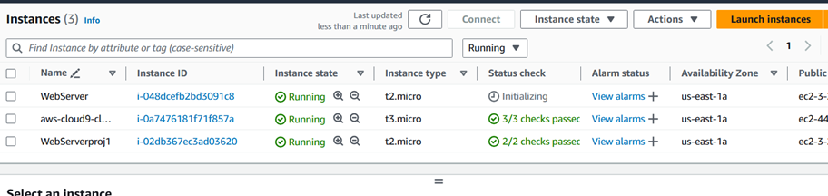
Provisioning a new instance for the web server

Slide 21
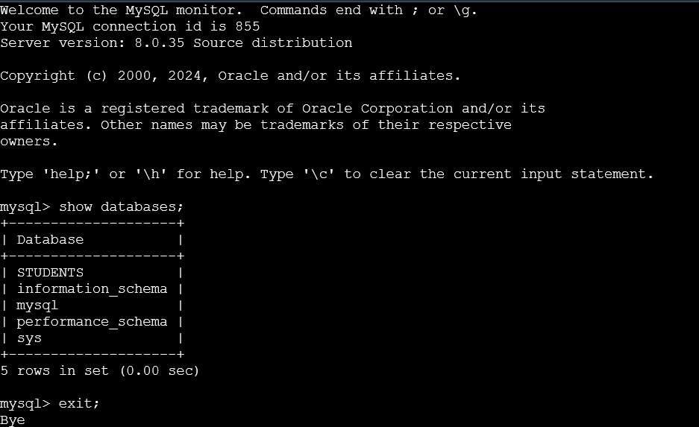
Migrating the database

Slide 22
Phase 4: Implementing high availability and scalability

Slide 23
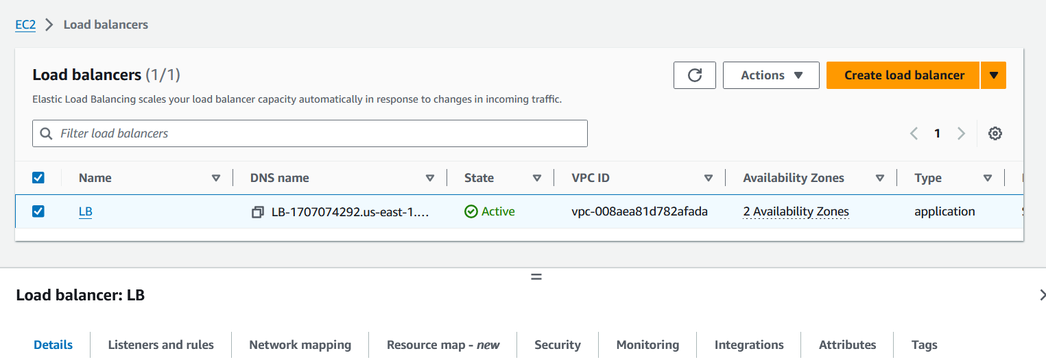
Creating an Application Load Balancer

Slide 24
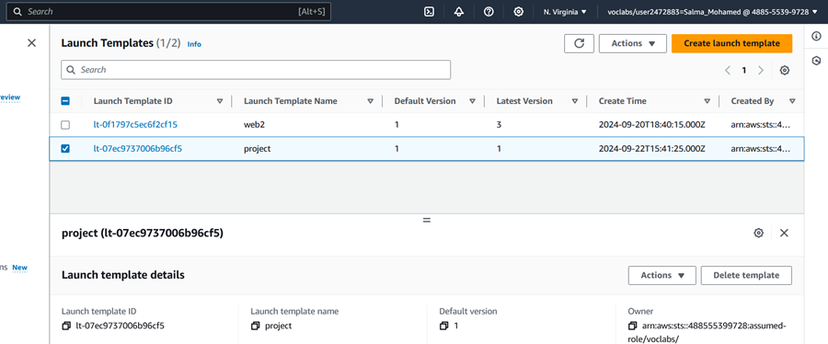
Implementing Amazon EC2 Auto Scaling

Slide 25
Creating an Application Load Balancer

Slide 26
Thank You

